Slide 1
Basic Details of the Team and Problem Statement
Problem Statement ID: 01
Problem Statement Title: Semantic Segmentation
Team Name: DL Detectives
Team Leader Name and Registration Number: Sourav Patel (21BCE5446)
Team members -
Name | Registration number
Ayush Omprakash Bhandari | 21BAI1124
Yashi Singh | 21BAI1655

Slide 2
Team Member Details
Sr. No. | Name of Team Member with Gender | Branch (Btech/Mtech/PhD etc): | Stream (Core CSE/Specialization): | Year | Position in team (Team Leader, Front end Developer, Back end Developer, Full Stack, Data base management etc.)
1 | Sourav Patel (male) | Btech | CSE Core | 2021-25 | Team Leader (Full Stack Developer)
2 | Yashi Singh (female) | Btech | CSE with Specialization in AI and ML | 2021-25 | Team member (ML Developer)
3 | Ayush Omprakash Bhandari (male) | Btech | CSE with Specialization in AI and ML | 2021-25 | Team member (Back End Developer)
Team Mentor/s Details
Sr. No. | Name of Mentor | Category (Academic/Industry): | Expertise (AI/ML/Blockchain etc): | Domain Experience (in Years )
1 | Dr. Sasithradevi. A | Academic | Image Processing, ML and DL | 13 years

Slide 3
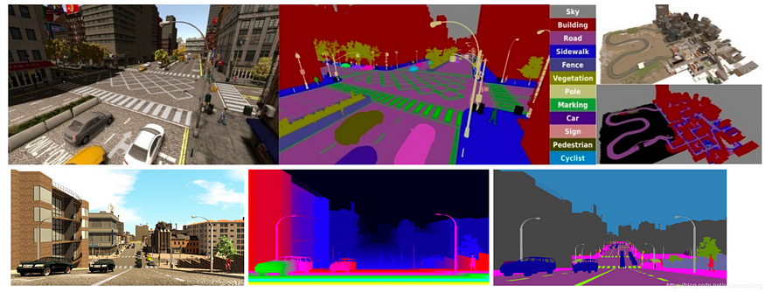
Idea/Approach Details
Explain your understanding of the problem statement.
The task is about accurately figuring out the main objects in videos. We're given a bunch of videos where each frame has clear markings showing which pixels belong to which object. So, we are supposed to perform Semantic Segmentation using a dataset with densely annotated video sequences. We are required to develop deep learning model to segment primary objects in each frame accurately, even in challenging scenarios such as occlusions, motion blur, and complex backgrounds. Evaluation metrics are Jaccard Index (IoU) and F1-score to measure the accuracy of the segmentation.

Slide 4
What pre-processing steps do you plan to perform on data, and have you considered any techniques to handle class imbalance if present?
Pre-processing Steps:
Data Augmentation: Apply transformations such as rotation, flipping, and scaling to increase dataset diversity.
Data Normalization: Normalize pixel values to a standard range for improved model training.
Handling Class Imbalance: Use techniques like class weights, oversampling, or focal loss to address class imbalances if present in the dataset.
Data Split: Divide the dataset into training and validation sets for model training and evaluation.
Techniques for Class Imbalance: For class imbalance, techniques like class weights in loss functions, oversampling minority classes, or using data augmentation specifically for underrepresented classes can be employed.

Slide 5
What model or techniques you plan to use?
For semantic segmentation tasks described in the hackathon, we plan to use deep learning models, particularly convolutional neural networks (CNNs). CNNs have proven to be highly effective in various computer vision tasks, including semantic segmentation, due to their ability to capture spatial dependencies and learn hierarchical features from images.
Specifically, we intend to explore architectures such as U-Net, DeepLab, or Mask R-CNN, which are well-suited for pixel-level segmentation tasks. These architectures incorporate features like skip connections, dilated convolutions, and multi-scale feature fusion, enabling them to handle complex scenarios like occlusions, motion blur, and dynamic backgrounds effectively.
Additionally, we plan to use pre-trained models on large-scale datasets like ImageNet to initialize the model's weights. Fine-tuning these pre-trained models on the provided dataset can speed up training and potentially improve performance, especially when the dataset size is limited.
We plan to integrate an attention mechanism into our semantic segmentation model. Specifically, we intend to use U-Net architecture augmented with an attention mechanism. This attention mechanism will allow the model to dynamically focus on relevant regions of the input image, enhancing its ability to capture fine details and improve segmentation accuracy.

Slide 6
What is your motivation for participating in the hackathon?
Our motivation for participating in the hackathon stems from our desire to apply our technical expertise in deep neural networks to real-world problems. The problem statement of semantic segmentation in video sequences presents an exciting opportunity to utilize our skills and knowledge in a practical scenarios, particularly in addressing images/videos with occlusions, motion blur, and complex backgrounds.
Furthermore, the prospect of securing an internship at Stryker, one of the leading companies in the field, serves as a compelling incentive. The opportunity to work with talented individuals in the industry and learn from their experiences is invaluable to our professional growth and development.
We are excited to contribute our skills and expertise to the competition and look forward to the learning and growth opportunities it presents.

Slide 7
Justification
Why did you choose this approach over others?
We chose the Semantic Segmentation task for the hackathon due to its relevance in computer vision and its practical applications across various domains. This task presents a challenging yet rewarding opportunity to work with densely annotated video sequences and develop deep learning models for accurate object segmentation.
Why did you choose the above pre-processing steps and how do you think they will effect your model performance?
We chose these pre-processing steps because they make the training data better for the model.
We plan to use data augmentation to diversify the training data, enabling the model to learn from a broader range of examples (basically increasing training dataset) by applying transformations like rotation, flipping, and color adjustments.
Normalization standardizes pixel values, and hence helps in faster and more stable learning by ensuring uniformity across the dataset.
Addressing class imbalance ensures equitable training by giving underrepresented objects more attention, preventing bias towards dominant classes.

Slide 8
Why do you think this particular model architecture/technique is better than others?
We believe the chosen model architecture and techniques are superior for several reasons. Firstly, deep learning models, particularly convolutional neural networks (CNNs), have demonstrated remarkable success in various computer vision tasks, including semantic segmentation.
We plan to choose model architectures like U-Net, FCN, and DeepLab (based on dataset) which are well-suited for semantic segmentation tasks due to their effectiveness in capturing spatial information and generating pixel-wise predictions.
Transfer learning with models like ResNet, VGG, or MobileNet allows us to use pre-trained features, enhancing model performance on limited data.
In addition to conventional architectures like U-Net, FCN, and DeepLab, we are also considering lightweight models for this problem statement based on recommendation we received from our mentor. Lightweight models, such as MobileNet and SqueezeNet, offer advantages in terms of computational efficiency and model size, making them particularly suitable for deployment on resource-constrained devices or real-time applications.

Slide 9
Describe in detail about your understanding of how the model works.
U-Net is a convolutional neural network (CNN) architecture designed for semantic segmentation tasks.
It comprises an encoder-decoder structure with skip connections.
The encoder extracts features and reduces spatial dimensions, while the decoder recovers spatial information using upsampling operations.
Skip connections merge low-level and high-level features to preserve fine details during segmentation.
During training, the model learns to minimize the difference between predicted and ground truth masks using pixel-wise loss functions.
U-Net effectively combines local and global contextual information to produce accurate segmentation masks.

Slide 10
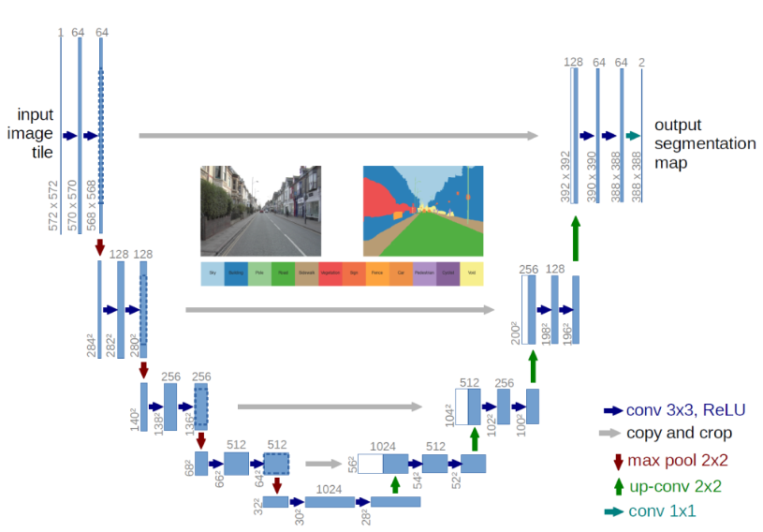

Slide 11
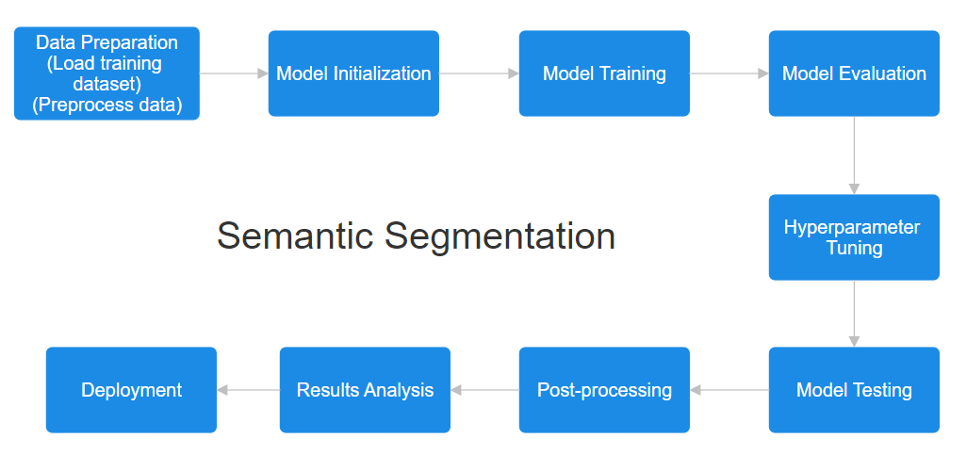
Process Flow Chart of our Solution

Slide 12
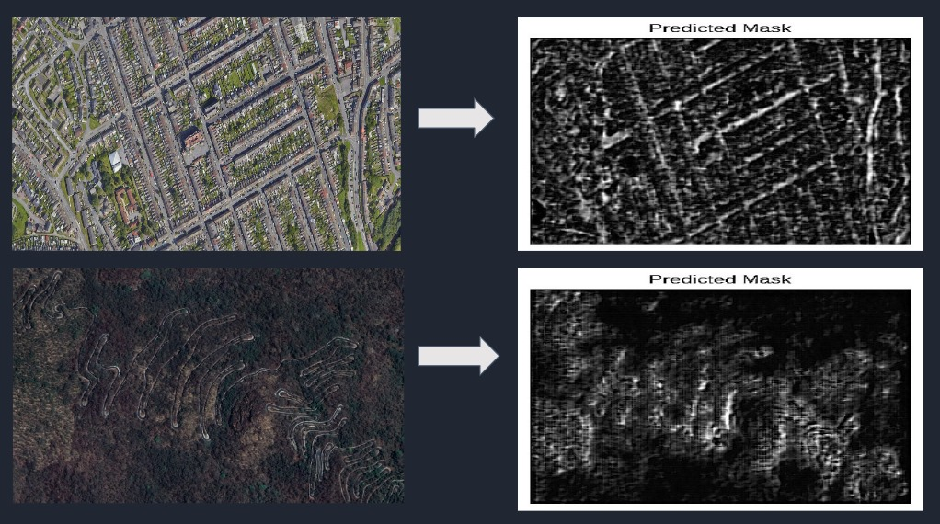
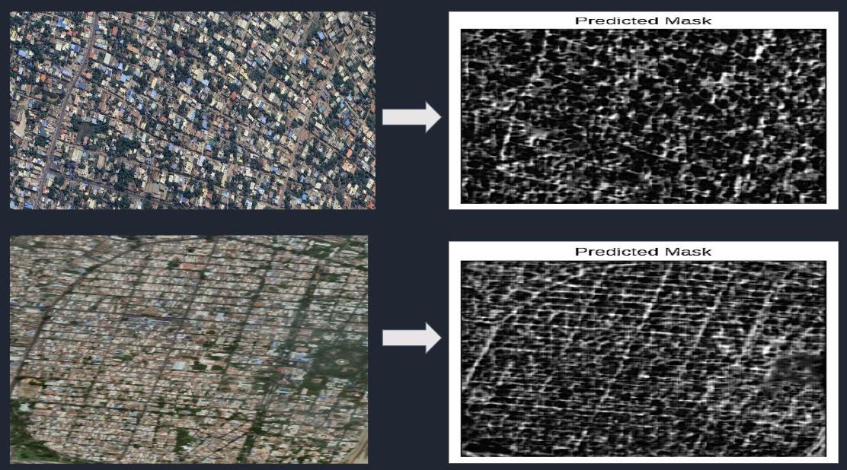
Details about similar work that we have attempted
Road network extraction
We used U-net segmentation technique to identify and extract road network patterns from satellite images for the telecommunication industry to lay optical fibre or telephone lines.

Slide 13
Idea/Approach Details
Any innovative ideas for this project
Describe your Dependencies / Show stopper here
Semantic Video Object Tracking: We wish to extend semantic segmentation to track objects across consecutive frames, maintaining consistent identities despite occlusions, appearance changes, and abrupt motion.
Real-Time Semantic Segmentation: We plant optimize the model for real-time performance to enable seamless integration into applications requiring real-time object segmentation, such as augmented reality (AR) or autonomous systems.
Semantic Segmentation for Autonomous Vehicles: Adapt the model for semantic segmentation tasks in the context of autonomous driving, enabling vehicles to accurately perceive and understand their surroundings for safe navigation.
Deep learning frameworks (PyTorch, TensorFlow)
Access to GPUs/TPUs for accelerated training
High-quality annotated datasets
Sufficient compute resources for training
Time and iterations for model convergence
Hyperparameter optimization
Organized codebase and version control (Git)
Appropriate evaluation metrics and validation
Planning for model deployment and integration.
Describe your Technology stack here:
PyTorch or TensorFlow for deep learning.
NumPy and OpenCV for data processing.
U-Net, DeepLab, or Mask R-CNN for model architecture.
Tools like TFX or Optuna for hyperparameter tuning.
Evaluation metrics using scikit-learn or TensorFlow Metrics.
Git for version control and collaboration.

Slide 14
References
https://www.researchgate.net/publication/360955328_SEMANTIC_SEGMENTATION_USING_A_UNET_ARCHITECTURE_ON_SENTINEL-2_DATA/fulltext/6295779c55273755ebc4c532/SEMANTIC-SEGMENTATION-USING-A-UNET-ARCHITECTURE-ON-SENTINEL-2-DATA.pdf
https://www.mdpi.com/2079-9292/12/12/2730
https://github.com/ashishpatel26/Andrew-NG-Notes/blob/master/andrewng-p-4-convolutional-neural-network.md
https://www.analyticsvidhya.com/blog/2021/10/understanding-transfer-learning-for-deep-learning/
https://medium.com/data-science-community-srm/comparative-study-of-image-segmentation-architectures-using-deep-learning-3743875fd608
https://cs230.stanford.edu/files/C4M3.pdf
https://github.com/Tramac/Lightweight-Segmentation

